Slide 1
Capstone Engagement
Assessment, Analysis, and Hardening of a Vulnerable System

Slide 2
Table of Contents
This document contains the following sections:
01
Network Topology
02
Red Team: Security Assessment
03
Blue Team: Log Analysis and Attack Characterization
Hardening: Proposed Alarms and Mitigation Strategies
04

Slide 3
Network Topology
‹#›

Slide 4
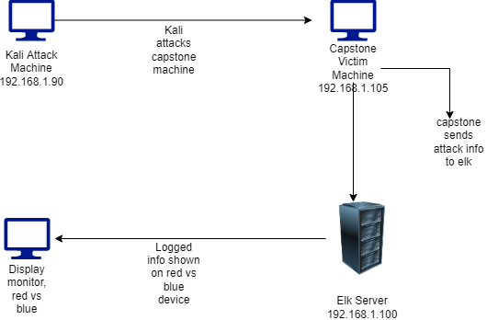
Network Topology
[Insert Here]
Use draw.io to create a diagram of the network.
Add your diagram to this slide and fill out the data in the sidebar.
Network
Address Range:192.168.1.0/24
Netmask: 255.255.255.0
Gateway: 192.168.1.1
Machines
IPv4:192.168.1.90
OS:2.6.32 linux
Hostname:kali
IPv4:192.168.1.105
OS:linux
Hostname: capstone
IPv4:192.168.0.100
OS:linux
Hostname:elk
IPv4:192.168.1.1
OS:windows
Hostname:Red vs Blue ML-REFVM

Slide 5

Red Team
Security Assessment
‹#›

Slide 6
Recon: Describing the Target
Nmap identified the following hosts on the network:
Hostname | IP Address | Role on Network
Red vs Blue ML-REFVM | 192.168.1.1 | Virtual host machine used to see the log data
Kali | 192.168.1.90 | Attack Machine
ELK | 192.168.1.100 | Log data from capstone machine
Capstone | 192.168.1.105 | Victim Machine

Slide 7
Vulnerability Assessment
The assessment uncovered the following critical vulnerabilities in the target:
Vulnerability | Description | Impact
Open port 80 | Open ports can allow attackers to access private information. This creates a larger risk for data loss | This allows red team to find private directory and access files within
Accessible files | Web servers stores files under “root” directory that is accessible to the users on the server | This allows red ream to view root files after accessing the ip on port 80 in browser, wherein after that red team obtained secret files
Brute force attack | When the password is too easy to guess it can be used in a brute force tool and wordlist to be hacked | This allowed red team to brute force Ashton’s password, which was Leopoldo and access secret files in the system
Hashed password | A hashed password can be cracked through different tools like john the ripper. Takes minutes to crack if not encrypted | This allowed red team to use md5cracker to identify the password for john which was linux4u

Slide 8
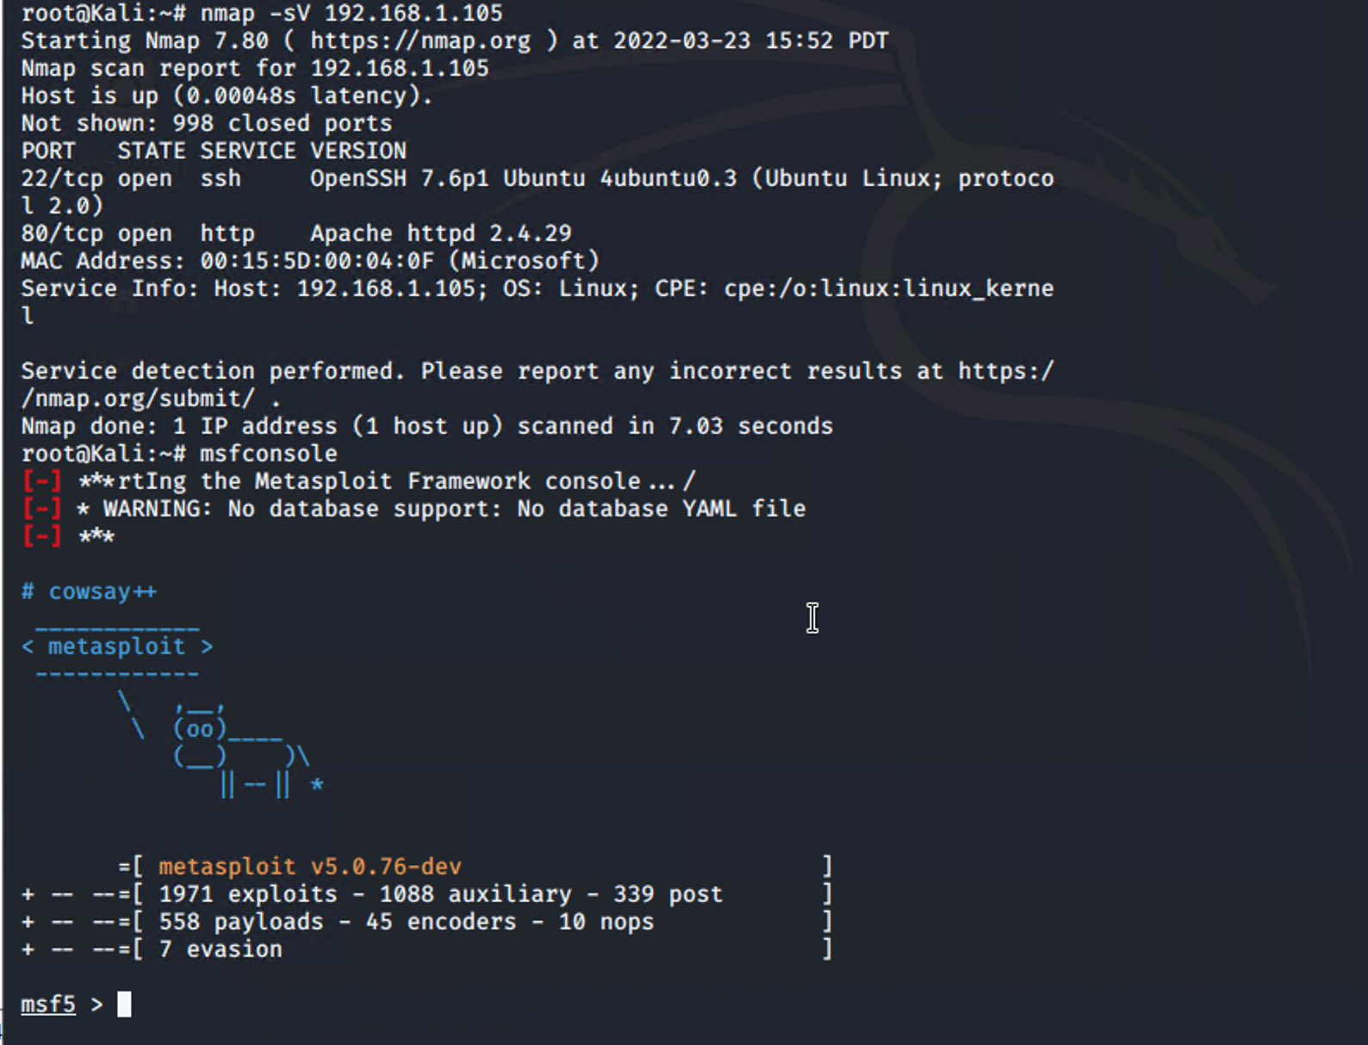
Exploitation: [open port 80]
01
02
03
Tools & Processes
We used nmap to scan for any open ports and services in the network
Achievements
We found that ip address 192.168.1.105 had an open port 80 to pass through, in which we were able to access the directory with important files
[INSERT: screenshot or command output illustrating the exploit.]

Slide 9
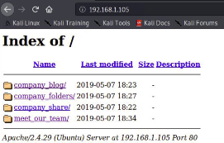
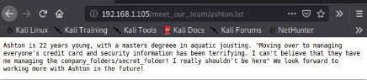
Exploitation: [Accessible files]
01
02
03
Tools & Processes
Using the open port 80, we opened a web browser to see if there was anything important to see
Achievements
Accessing the files gave us intel which the users had access to the secret files we were looking for

Slide 10
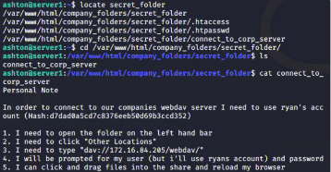
Exploitation: [Brute Force]
01
02
03
Tools & Processes
We uses Hydra to brute force Ashton’s password with his user name…..ashton
Achievements
The exploit allows user shell access to the target machine in order to obtain the secret files

Slide 11
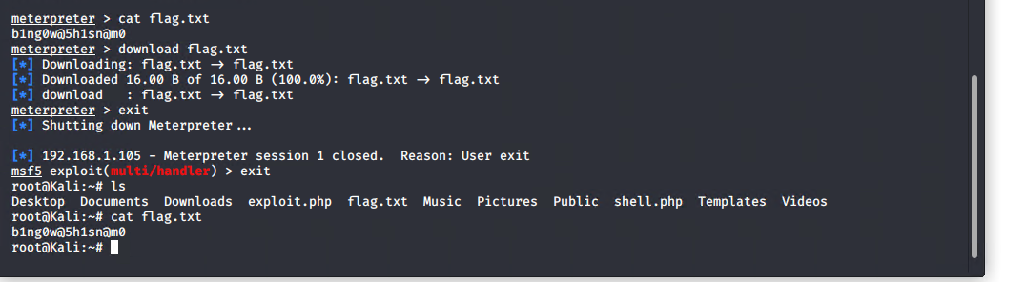
Consequences of poor security configuration and integrity

Slide 12

Blue Team
Log Analysis and Attack Characterization
‹#›

Slide 13

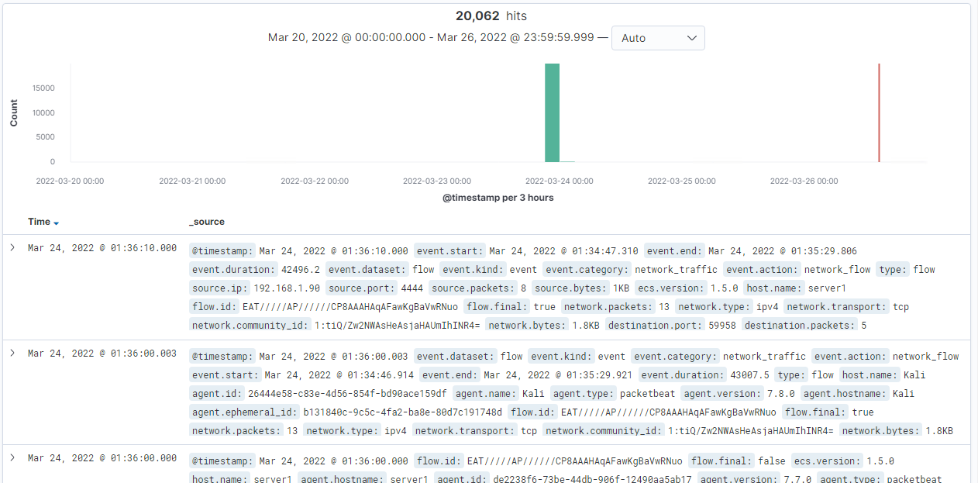
Analysis: Identifying the Port Scan
Answer the following questions in bullet points under the screenshot if space allows. Otherwise, add the answers to speaker notes.
About 6pm (not in VM time) is when scan started
20,062 packets were sent from 192.168.1.90
Nmap ping scans sends request to the 443 port, so filtering that showed results below
[Insert Here]
Include a screenshot of Kibana logs depicting the port scan.

Slide 14
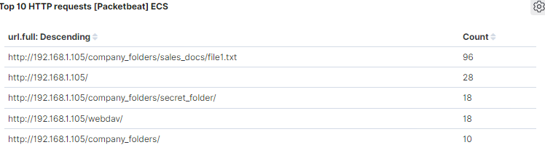
Analysis: Finding the Request for the Hidden Directory
Answer the following questions in bullet points under the screenshot if space allows. Otherwise, add the answers to speaker notes.
The requests occurred at around 6:30pm, contained 18 requests for secret directory
Secret files were requested, contained the instructions to use webdav to ssh into the capstone vm
[Insert Here]
Include a screenshot of Kibana logs depicting the request for the hidden directory.

Slide 15
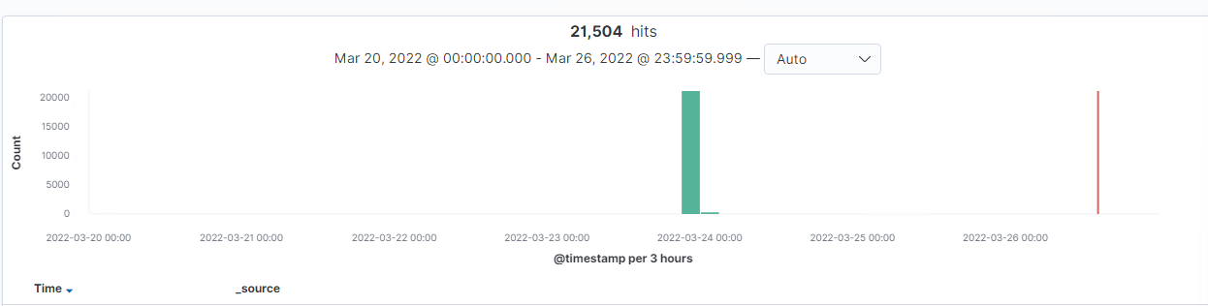
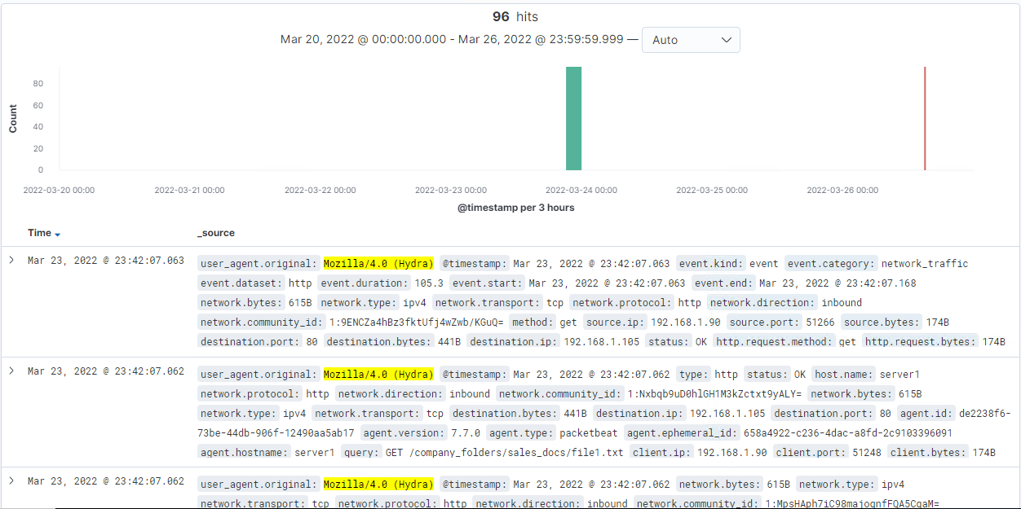
Analysis: Uncovering the Brute Force Attack
Answer the following questions in bullet points under the screenshot if space allows. Otherwise, add the answers to speaker notes.
21,504 attempts were made for brute force attack
96 requests were made before password was found
[Insert Here]
Include a screenshot of Kibana logs depicting the brute force attack.

Slide 16
Analysis: Finding the WebDAV Connection
Answer the following questions in bullet points under the screenshot if space allows. Otherwise, add the answers to speaker notes.
18 requests were made for webdav
Shell.php file was requested, which is what redteam put on the victim machine as apart of listening in the shell attack
[Insert Here]
Add a screenshot of Kibana logs depicting the WebDAV connection.

Slide 17
Blue Team
Proposed Alarms and Mitigation Strategies
‹#›
Notes:
How can we configure our firewalls and systems to mitigate these vulnerabilities based on the SEIM data?

Slide 18
Mitigation: Blocking the Port Scan
Set an alarm that detects port scans that are aggressive or for when nmap is used at all.
Set an alarm for when a rarely used port is scanned (7,9,19)
Scans of rarely used ports of a few or more should trigger an alarm.
To mitigate port scans you could allow only local network access and deny external traffic.
Redirect to a honeypot.
Iptables to set up a honeypot and create logs to highlight the intrusion on a monitoring dashboard.

Slide 19
Mitigation: Finding the Request for the Hidden Directory
We can set alarms to trigger when sensitive directory is accessed more than a number of times in a given period of time.
Threshold will be 3x.
Remove the directory from main file server to remove from public view
“rm -r ../company_files”
Don't announce the path to secret folder in any documents.
Firewalld Configurations:
“sudo firewalld-cmd --permanent--new-zone=encrypted”
Add verified IP address
“sudo firewall-cmd --zone=drop --permanent --add-source=<IP>”

Slide 20
Mitigation: Preventing Brute Force Attacks
A critical alarm can be set if there are more than 10 attempts on the same user account trying to be accessed. While also setting low level alarms for more than 3 failed attempts. Also, alert triggers can be based on established trends of each user.
Follow windows server lockout policy (something like Local Group Policy Editor GPE)
Direct Brute Force Attackers to a Honeypot
Create a blacklist of malicious IPs based on attempts in the past 6 months and can lead to re-education if an employee is involved
Password complexity requirement
MFA
CAPCHAs
account lockouts
account timeouts

Slide 21
Mitigation: Detecting the WebDAV Connection
Create and alert any time directory is accessed by a user other than the user with proper clearance
Create a whitelist of trusted ip and review every 6 months, set alerts for any non-whitelisted IP trying to connect to WebDAV
On HTTP GET request, set an alarm that activates on an ip address that tries to access webdav
Threshold can be set to one attempt
Limit user access to webdav
Harden webdav authentication
Scanning incoming traffic with anti virus software
Update regularly
Upgrade to more secure applications
Only use webdav with internal access within the company

Slide 22
Mitigation: Identifying Reverse Shell Uploads
Set an alarm for anything using port 4444
Set an alarm for use of any suspicious file extension or scripts. in the server
Set an alarm for anything triggered by an anti-virus software.
Threshold should be set at 1 attempt
Remove ability to upload files to this directory through the web interface
Disabling HTTP PUT method to prevent file uploading.
Setup secure anti-virus application to screen all incoming files with daily automatic update.
Update firewall rules bi-monthly

Slide 24
Contributions to all slides made by:
Kieran Selengut
George Kasper
Stephan Williams
Max Dawson
Arthur Street

